Slide 1
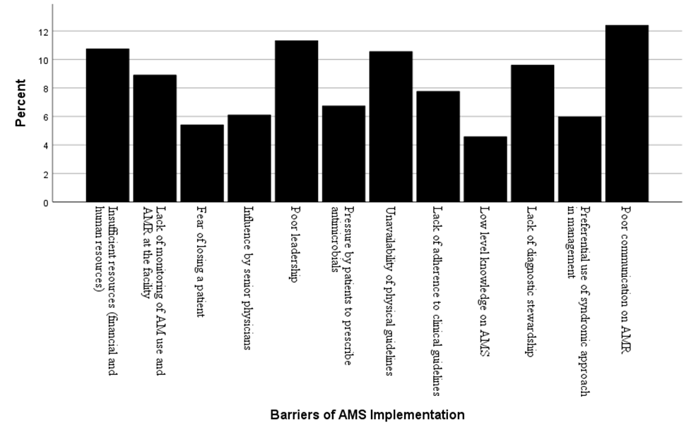
AN ASSESSMENT OF ANTIMICROBIAL STEWARDSHIP STATUS IN KAPSABET COUNTY REFERRAL HOSPITAL, NANDI COUNTY, KENYA
Kipkemoi Moreen, MPH, PhD©¹; Joseph Muchiri, PhD²; Violet Maritim,PhD^{,2}
^{1,2}Mount Kenya University of Affiliation, ¹Kenya Medical Training College
Introduction
Results
The alarming burden of antimicrobial resistance (AMR) foreshadows the health status of persons in developing nations (1).
In Africa, AMR has surpassed pathologies such as malaria, HIV, and TB to emerge as a leading cause of mortality within the region
Projections shows a fourfold rise of AMR linked deaths to reach 4.1 million annually in the continent.
In Kenya, an estimated 8,500 deaths is directly attributable AMR, while 37,300 deaths are associated with AMR (3).
The pertinent need for antimicrobial stewardship (AMS) has been orchestrated by the rising rates of AMR
Antimicrobial stewardship programs have a pivotal part in encouraging the rational usage of antimicrobials within hospital settings2
Assessing of the key indicators of Antimicrobial Stewardship Program (ASP) in healthcare facility settings is a practical way of determining the drivers and barriers of AMS.
This study assessed the status of antimicrobial stewardship in Kapsabet County Referral Hospital in Nandi County.
Objectively, it assessed health care workers awareness on antimicrobial stewardship; factors that drive antimicrobial stewardship program as well as the barriers for effective antimicrobial stewardship implementation at Kapsabet County Referral Hospital in Nandi County.
The study determined that the antimicrobial stewardship status at Kapsabet County Referral Hospital was not well developed, with 54% of the respondents rating the AMS program as below average.
Respondents cited irrational prescription as a major challenge, “there is general knowledge gaps on AMS in the facility. All patients in the wards come with already prescribed and initiated antibiotics,”
The core interventions that drive AMS program were partially implemented, despite health care workers demonstrating awareness and an understanding of antimicrobial stewardship.
Optimal antimicrobial usage through documentation of drug dosage, duration and indication was the main driver of AMS program
Poor communication on antimicrobial resistance, poor leadership and insufficient resources were cited as the most common barriers for effective implementation of antimicrobial stewardship.
The coefficient of determination or R2 showed that the explanatory variables studied accounted for 81.5% of the effects of the outcome variable.
Factors driving AMS and barriers for effective implementation were significant coefficients affecting AMS positively and negatively respectively.
The level of awareness was statistically not significant.
Methods and Materials
The study employed the use of a descriptive, cross-sectional study design.
It targeted medical officers, pharmacists and clinical officers.
Study approvals were secured from National Commission for Science, Technology and Innovation (NACOSTI), MKU research committee and Kapsabet County Referral Hospital.
Quantitative and qualitative data was collected and analyzed
A total of 63 respondents filed the structured questionnaires and checklists that were distributed to the sampled population.
Chart 1. Barriers of AMS Implementation
Discussion
AMS in health facilities are not well established as shown by the inadequacies of critical AMS complementary elements (4).
This depicts a fragmented AMS status despite the dire need of the programs in reducing the burden of AMR.
Health care workers awareness, knowledge and attitudes may not necessarily correlate with AMS practices.
The low stewardship status may contribute towards steady rise of AMR in Kenya.
A combination of leadership support, HCW education with other AMS interventions may result in better stewardship outcomes at facility level.
Conclusions
The study concluded that even though the antimicrobial stewardship is not well-developed, the health care workers demonstrated awareness, with optimal antimicrobial usage through documentation of drug dosage, duration and indication as the main driver of AMS program at the facility.
Contact
References
Kipkemoi Moreen
Kenya Medical Training College
Email: mkipkemoi@kmtc.ac.ke
Website: www.kmtc.ac.ke
WHO. 2022. Kenya national action plan on antimicrobial resistance: Review of progress in the human health sector. Geneva: World Health Organization; 2022 (Antimicrobial resistance policy information and action brief series). Licence: CC BY-NC-SA 3.0 IGO
Government of Kenya. (2020). National antimicrobial stewardship guidelines for health care settings in Kenya. Ministry of Health. https://www.health.go.ke/wp-content/uploads/2021/09/National-Antimicrobial-Stewardship-Guidelines-for-health-care-settings-In-Kenya-2020.pdf
Institute for Health Metrics and Evaluation. (2023). The burden of antimicrobial resistance (AMR) in Kenya. https://www.healthdata.org/sites/default/files/2023-09/Kenya.pdf
Mbugua, S. M., Njoroge, G., Kijogi, C., Kamita, M., Kimani, R., Mwaura, P., Aidi, B. W., & Gitaka, J. (2020). Exploring perspectives on antimicrobial stewardship: A qualitative study of health managers in Kenya. Global Health Research and Policy, 5, 49. https://doi.org/10.1186/s41256-020-00177-w

